Slide 1
Conflict between fantasy and reality

Slide 2
The image of Catherine
Full of imagination
Young and naive
Obsessed with gothic fiction

Slide 3
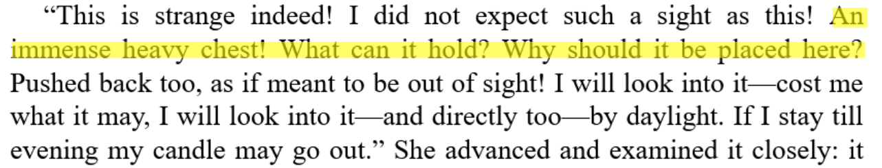
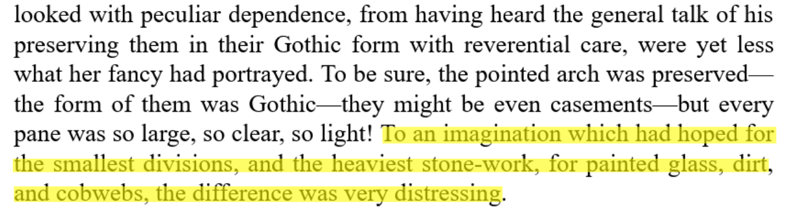
The image of Catherine
Disappointment when meeting reality：

Slide 4
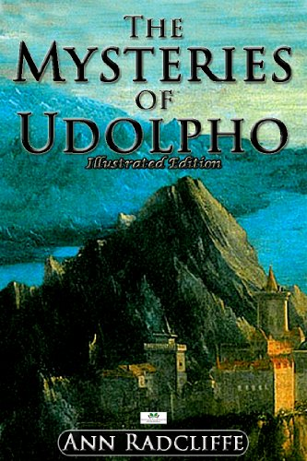
Evaluations of Gothic fiction at the time
Samuel Johnson：The rational requirement of fiction is the dissemination of truth
Jane Austin：Influence readers to explore the world and seek to understand it

Slide 5
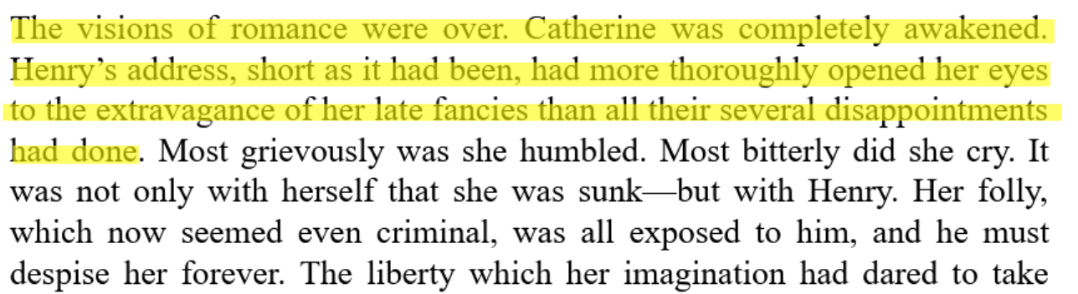
Reflection and Growth
illusion shattered
Catherine gained experience from it

Slide 6
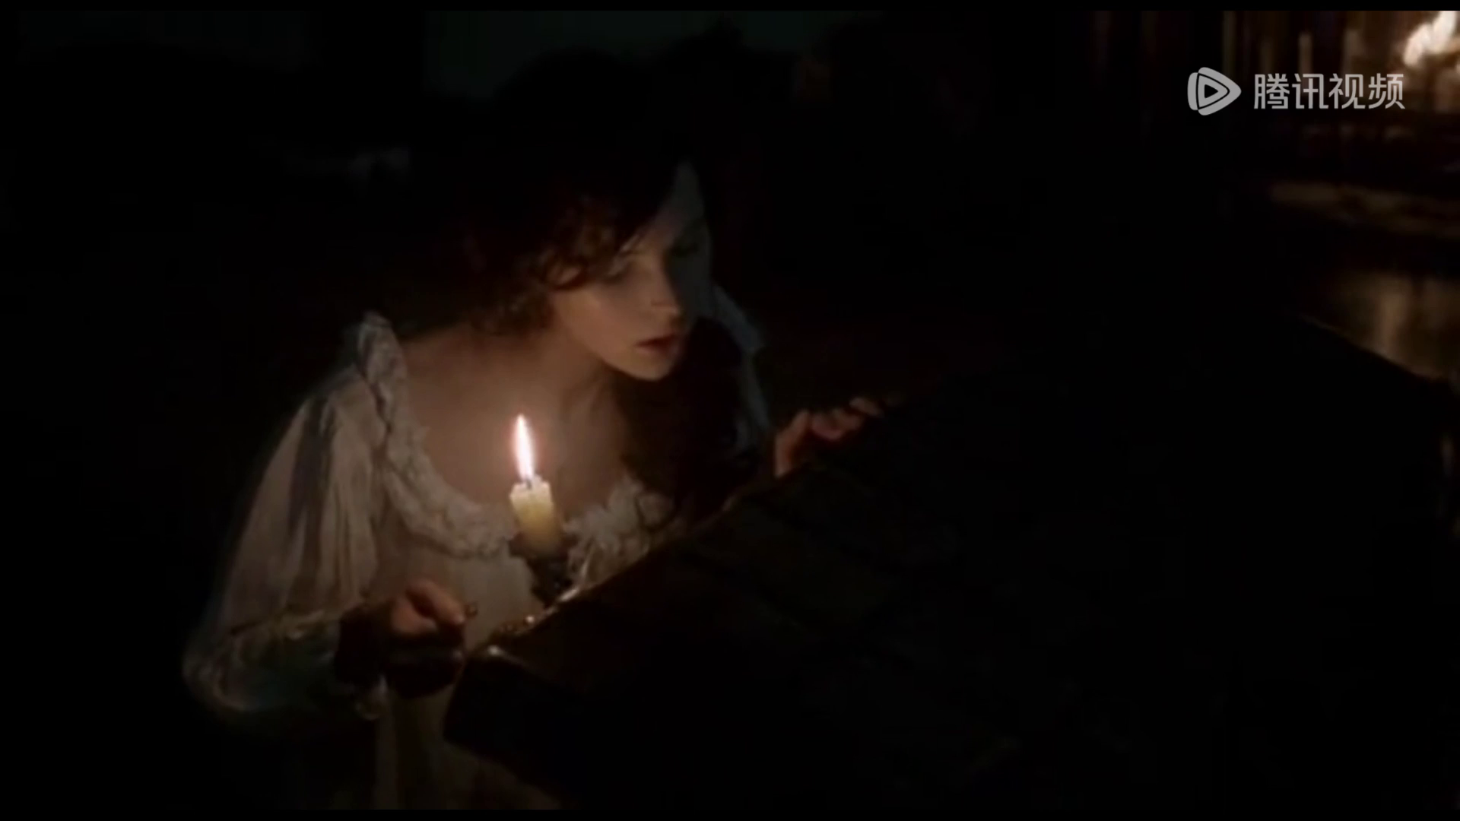
Movie's portrayal

Slide 7
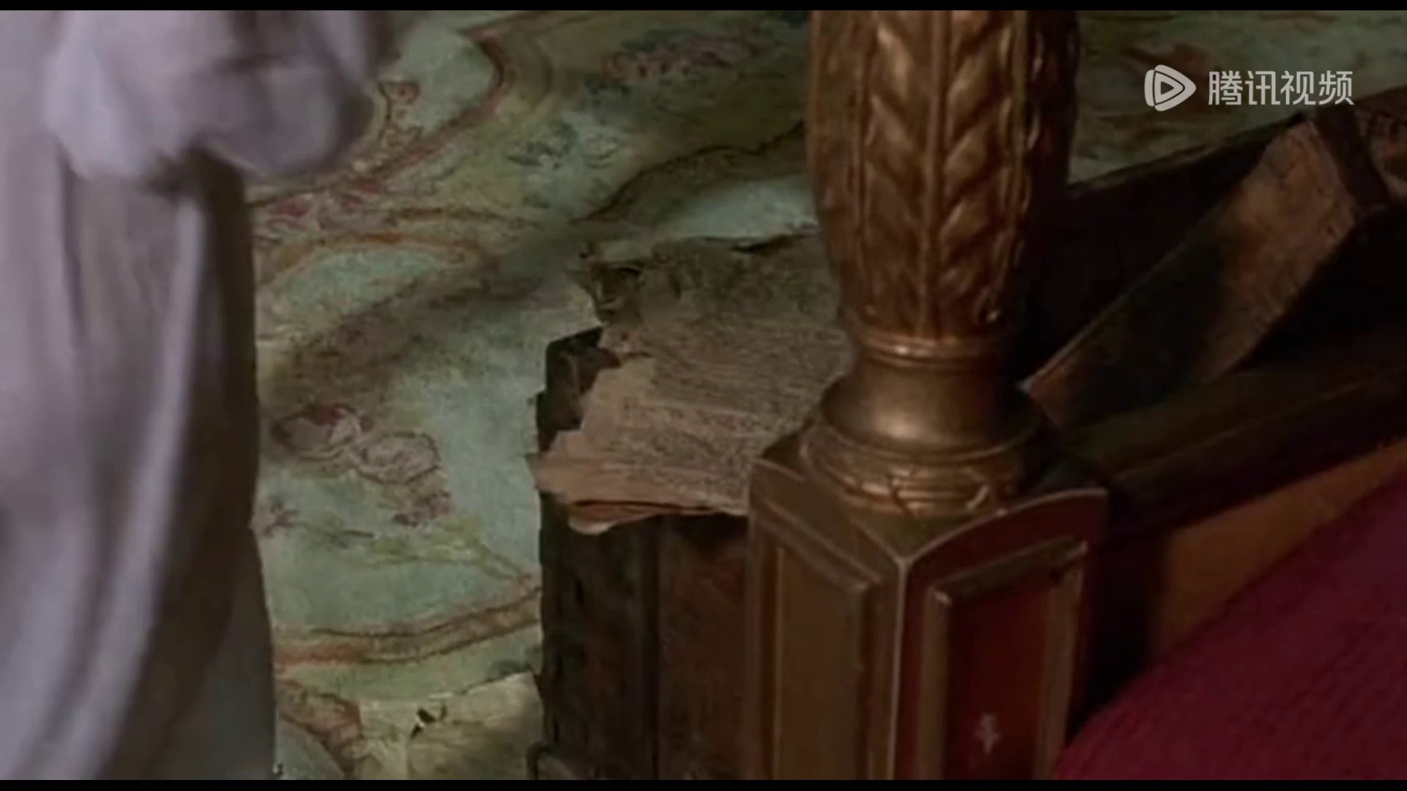
Movie's portrayal

